Slide 1
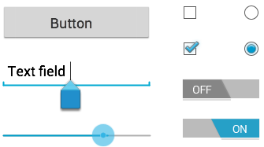
Common Controls

Slide 2

Buttons
A button consists of text or an icon (or both text and an icon) that communicates what action occurs when the user touches it.

Slide 3
Buttons
With text, using the Button class
<Button
android:layout_width="wrap_content"
android:layout_height="wrap_content"
android:text="@string/button_text"
... />

Slide 4
Buttons
With an icon, using the ImageButton class
<ImageButton
android:layout_width="wrap_content"
android:layout_height="wrap_content"
android:src="@drawable/button_icon"
... />

Slide 5
Buttons
With text and an icon, using the Button class with the android:drawableLeft attribute
<Button
android:layout_width="wrap_content"
android:layout_height="wrap_content"
android:text="@string/button_text"
android:drawableLeft="@drawable/button_icon"
... />

Slide 6
Buttons
Responding to Click Events
When the user clicks a button, the Button object receives an on-click event.
To define the click event handler for a button, add the android:onClick attribute to the <Button> element in your XML layout.
<?xml version="1.0" encoding="utf-8"?>
<Button xmlns:android="http://schemas.android.com/apk/res/android"
android:id="@+id/button_send"
android:layout_width="wrap_content"
android:layout_height="wrap_content"
android:text="@string/button_send"
android:onClick="sendMessage" />

Slide 7
Buttons
Responding to Click Events
Within the Activity that hosts this layout, the following method handles the click event
The method you declare in the android:onClick attribute must have a signature exactly as shown. Specifically, the method must be public, return void, and define a View as its only parameter (this will be the View that was clicked)
/** Called when the user touches the button */
public void sendMessage(View view) {
// Do something in response to button click
}

Slide 8
Buttons
Using an OnClickListener (Dynamically)
To declare the event handler programmatically, create an View.OnClickListener object and assign it to the button by calling setOnClickListener(View.OnClickListener).
Button button = (Button) findViewById(R.id.button_send);
button.setOnClickListener(new View.OnClickListener() {
public void onClick(View v) {
// Do something in response to button click
}
});

Slide 9
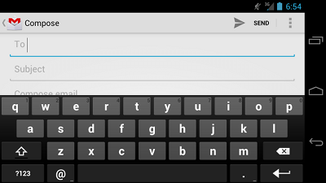
Text Fields
A text field allows the user to type text into your app. It can be either single line or multi-line.

Slide 10
Text Fields
Touching a text field places the cursor and automatically displays the keyboard.
In addition to typing, text fields allow for a variety of other activities, such as
text selection (cut, copy, paste)
data look-up via auto-completion.

Slide 11
Text Fields
Text fields can have different input types, such as
number, date, password, or email address.
The type determines what kind of characters are allowed inside the field, and may prompt the virtual keyboard to optimize its layout for frequently used characters.

Slide 12
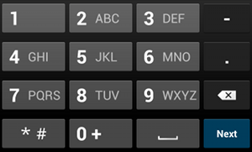
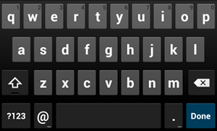
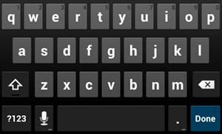
Text Fields
Figure 3. The phone input type.
Figure 2. The textEmailAddress input type.
Figure 1. The default text input type

Slide 13
Text Fields
You can specify the type of keyboard you want for your EditText object with the android:inputType attribute.
<EditText
android:id="@+id/email_address"
android:layout_width="fill_parent"
android:layout_height="wrap_content"
android:hint="@string/email_hint"
android:inputType="textEmailAddress" />

Slide 14
Text Fields
Here are some of the more common values for android:inputType:
"text"
Normal text keyboard.
"textEmailAddress"
Normal text keyboard with the @ character.
"textUri"
Normal text keyboard with the / character.
"number"
Basic number keypad.
"phone"
Phone-style keypad.

Slide 15
Text Fields: Controlling other behaviors
Controlling other behaviors
The android:inputType also allows you to specify certain keyboard behaviors, such as
whether to capitalize all new words
or use features like auto-complete and spelling suggestions etc.

Slide 16
Text Fields: Controlling other behaviors
Here are some of the common input type values that define keyboard behaviors:
"textCapSentences"
Normal text keyboard that capitalizes the first letter for each new sentence.
"textCapWords"
Normal text keyboard that capitalizes every word. Good for titles or person names.
"textAutoCorrect"
Normal text keyboard that corrects commonly misspelled words.
"textPassword"
Normal text keyboard, but the characters entered turn into dots.
"textMultiLine"
Normal text keyboard that allow users to input long strings of text that include line breaks (carriage returns).

Slide 17
Text Fields: Controlling other behaviors
<EditText
android:id="@+id/postal_address"
android:layout_width="fill_parent"
android:layout_height="wrap_content"
android:hint="@string/postal_address_hint"
android:inputType="textPostalAddress|
textCapWords|
textNoSuggestions" />

Slide 18

Text Fields: Specifying Keyboard Actions
Android allows you to specify an action to be made when users have completed their input.
The action specifies the button that appears in place of the carriage return key and the action to be made, such as "Search" or "Send."
Figure 4. If you declare android:imeOptions="actionSend", the keyboard includes the Send action.

Slide 19
Text Fields: Specifying Keyboard Actions
You can specify the action by setting the android:imeOptions attribute. You must use inputType=“text” to work imeOptions. For example, here's how you can specify the Send action:
<EditText
android:id="@+id/search"
android:layout_width="fill_parent"
android:layout_height="wrap_content"
android:hint="@string/search_hint"
android:inputType="text"
android:imeOptions="actionSend" />

Slide 20
Text Fields: Specifying Keyboard Actions
If you do not explicitly specify an input action then the system attempts to determine if there are any subsequent android:focusable fields.
If any focusable fields are found following this one, the system applies the (@code actionNext} action to the current EditText so the user can select Next to move to the next field.
If there's no subsequent focusable field, the system applies the "actionDone" action. You can override this by setting the android:imeOptions attribute to any other value such as "actionSend" or "actionSearch" or suppress the default behavior by using the "actionNone" action.

Slide 21
Responding to action button events
You can listen for the specific action event using an TextView.OnEditorActionListener. The TextView.OnEditorActionListener interface provides a callback method called onEditorAction() that indicates the action type invoked with an action ID such as IME_ACTION_SEND or IME_ACTION_SEARCH.

Slide 22
Responding to action button events
EditText editText = (EditText) findViewById(R.id.search);
editText.setOnEditorActionListener(new OnEditorActionListener() {
@Override
public boolean onEditorAction(TextView v, int actionId, KeyEvent event) {
boolean handled = false;
if (actionId == EditorInfo.IME_ACTION_SEND) {
//Do something here
handled = true;
}
return handled;//We have consumed the action
}
});

Slide 23
Setting a custom action button label
If the keyboard is too large to reasonably share space with the underlying application (such as when a handset device is in landscape orientation) then fullscreen ("extract mode") is triggered. In this mode, a labeled action button is displayed next to the input.
You can customize the text of this button by setting the android:imeActionLabel attribute:

Slide 24
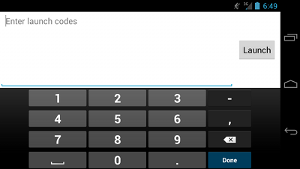
Setting a custom action button label
<EditText
android:id="@+id/launch_codes"
android:layout_width="fill_parent"
android:layout_height="wrap_content"
android:hint="@string/enter_launch_codes"
android:inputType="number"
android:imeActionLabel="@string/launch" />

Slide 25
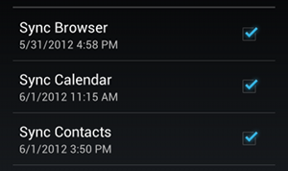
Checkboxes
Checkboxes allow the user to select one or more options from a set.
Typically, you present each checkbox option in a vertical list.

Slide 26
Checkboxes: Responding to Click Events
When the user selects a checkbox, the CheckBox object receives an on-click event.
To define the click event handler for a checkbox, add the android:onClick attribute to your XML layout.
The value for this attribute must be the name of the method you want to call in response to a click event.
The Activity hosting the layout must then implement the corresponding method.

Slide 27
Checkboxes: Responding to Click Events
<?xml version="1.0" encoding="utf-8"?>
<LinearLayout xmlns:android="http://schemas.android.com/apk/res/android"
android:orientation="vertical"
android:layout_width="fill_parent"
android:layout_height="fill_parent">
<CheckBox android:id="@+id/checkbox_meat"
android:layout_width="wrap_content"
android:layout_height="wrap_content"
android:text="@string/meat"
android:onClick="onCheckboxClicked"/>
<CheckBox android:id="@+id/checkbox_cheese"
android:layout_width="wrap_content"
android:layout_height="wrap_content"
android:text="@string/cheese"
android:onClick="onCheckboxClicked"/>
</LinearLayout>

Slide 28
Checkboxes: Responding to Click Events
public void onCheckboxClicked(View view) {
// Is the view now checked?
boolean checked = ((CheckBox) view).isChecked();
// Check which checkbox was clicked
switch(view.getId()) {
case R.id.checkbox_meat:
if (checked)
// Put some meat on the sandwich
else
// Remove the meat
break;
case R.id.checkbox_cheese:
if (checked)
// Cheese me
else
// I'm lactose intolerant
break;
// TODO: Veggie sandwich
}
}

Slide 29

RadioButton
Radio buttons allow the user to select one option from a set.
You should use radio buttons for optional sets that are mutually exclusive.

Slide 30
RadioButton
To create each radio button option, create a RadioButton in your layout.
However, because radio buttons are mutually exclusive, you must group them together inside a RadioGroup.
By grouping them together, the system ensures that only one radio button can be selected at a time.
RadioGroup
RadioButton
RadioButton
RadioButton

Slide 31
Checkboxes-Responding to Click Events
When the user selects one of the radio buttons, the corresponding RadioButton object receives an on-click event.
To define the click event handler for a button, add the android:onClick attribute to your XML layout.
The value for this attribute must be the name of the method you want to call in response to a click event.
The Activity hosting the layout must then implement the corresponding method.
The RadioGroup is a subclass of LinearLayout that has a vertical orientation by default.

Slide 32
Checkboxes-Responding to Click Events
<?xml version="1.0" encoding="utf-8"?>
<RadioGroup xmlns:android="http://schemas.android.com/apk/res/android"
android:layout_width="fill_parent"
android:layout_height="wrap_content"
android:orientation="vertical">
<RadioButton android:id="@+id/radio_pirates"
android:layout_width="wrap_content"
android:layout_height="wrap_content"
android:text="@string/pirates"
android:onClick="onRadioButtonClicked"/>
<RadioButton android:id="@+id/radio_ninjas"
android:layout_width="wrap_content"
android:layout_height="wrap_content"
android:text="@string/ninjas"
android:onClick="onRadioButtonClicked"/>
</RadioGroup>

Slide 33
Checkboxes-Responding to Click Events
public void onRadioButtonClicked(View view) {
// Is the button now checked?
boolean checked = ((RadioButton) view).isChecked();
// Check which radio button was clicked
switch(view.getId()) {
case R.id.radio_pirates:
if (checked)
// Pirates are the best
break;
case R.id.radio_ninjas:
if (checked)
// Ninjas rule
break;
}
}

Slide 34
CompoundButton
A button with two states, checked and unchecked. When the button is pressed or clicked, the state changes automatically
CompoundButton
CheckBox
RadioButton
Switch
ToggleButton

Slide 35

CompoundButton
switchBT=(Switch)findViewById(R.id.switchBT);
switchBT.setOnCheckedChangeListener(new CompoundButton.OnCheckedChangeListener() {
@Override
public void onCheckedChanged(CompoundButton btn, boolean isChecked) {
}
});

Slide 36
CompoundButton
OR WE CAN USE android:onClick attribute
What will be the difference?

Slide 37
Toggle Buttons
A toggle button allows the user to change a setting between two states.
You can add a basic toggle button to your layout with the ToggleButton object.
Android 4.0 (API level 14) introduces another kind of toggle button called a switch that provides a slider control, which you can add with a Switch object.

Slide 38
Toggle Buttons
When the user selects a ToggleButton and Switch, the object receives an on-click event.
To define the click event handler, add the android:onClick attribute to the <ToggleButton> or <Switch> element in your XML layout.
The value for this attribute must be the name of the method you want to call in response to a click event.
The Activity hosting the layout must then implement the corresponding method.

Slide 39
Toggle Buttons
<ToggleButton
android:id="@+id/togglebutton"
android:layout_width="wrap_content"
android:layout_height="wrap_content"
android:textOn="Vibrate on"
android:textOff="Vibrate off"
android:onClick="onToggleClicked"/>

Slide 40
Toggle Buttons
public void onToggleClicked(View view) {
// Is the toggle on?
boolean on = ((ToggleButton) view).isChecked();
if (on) {
// Enable vibrate
} else {
// Disable vibrate
}
}

